Slide 1


Fetal Health Classification DSC 630 -Final Project Evelyn Cates

Slide 2
Introduction
Problem
Predicting fetal health during pregnancy in order to prevent child and maternal mortality.
Solution
Build a classification model to identify potential risks and address high risk findings early.
Data Information
Fetal health is classified into 3 types: Normal (1), Suspect (2), Pathological (3).
Dataset has: 22 columns, 2126 entries and no missing values.
Notes:
There have been declines in fetal and maternal mortality rates but not enough for preventable cases. According to the UN 94% of maternal mortality could be prevented and typically occur in low resource areas.

Slide 3
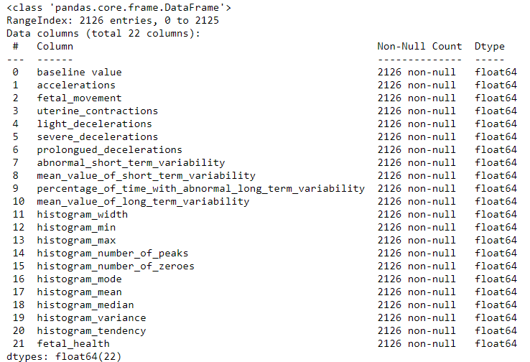
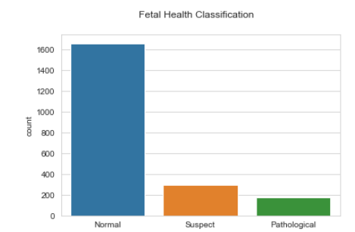
Exploratory Data Analysis

Slide 4
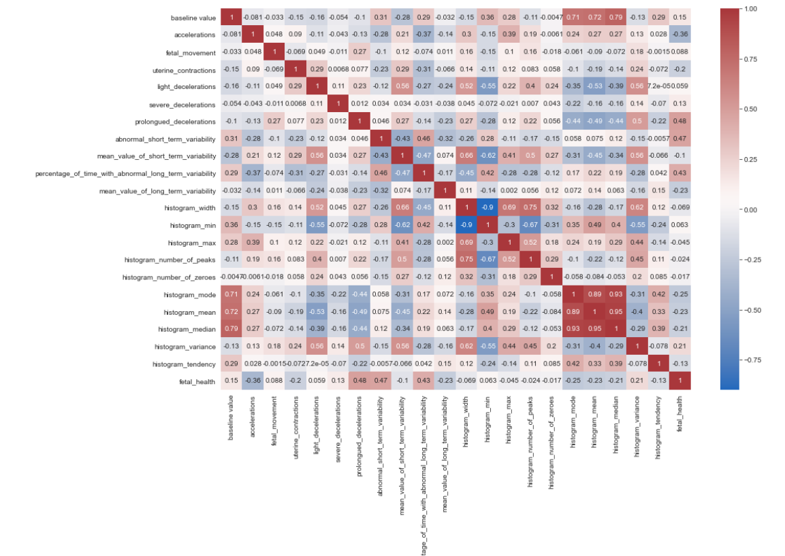
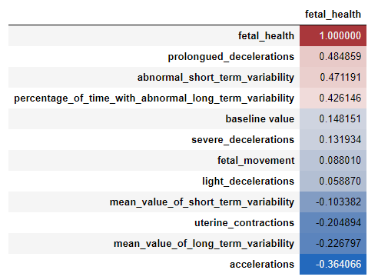
Exploratory Data Analysis – Feature Selection
Notes:
The columns with the highest correlation are:
Prolonged decelerations – are considered heart decelerations lasting more than 3 mins
Abnormal Short-Term Variability -is less than 5 beats per min for more than 50 mins
Percentage of Time with Abnormal Long-Term Variability
Will focus on these columns to create the prediction models.

Slide 5
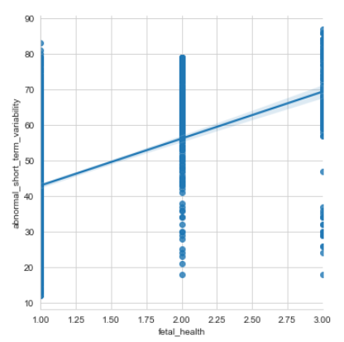
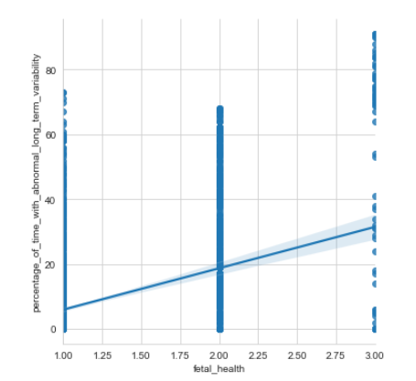
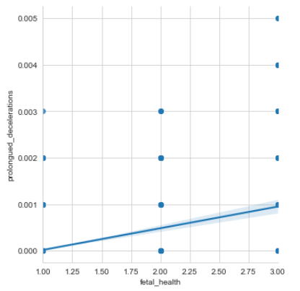
Exploratory Data Analysis – Feature Selection
Linear Regression models to further understand correlation between chosen variables.

Slide 6
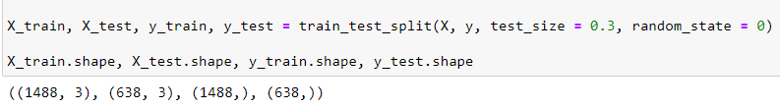
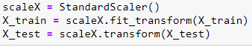
Model Creation
Train Test Split
Preprocessing
Notes:
Split the data 70/30
Used StandardScaler- it removes mean variables and scaled each feature and variable to a unit variance. There aren’t any outliers that would influence the results.

Slide 7
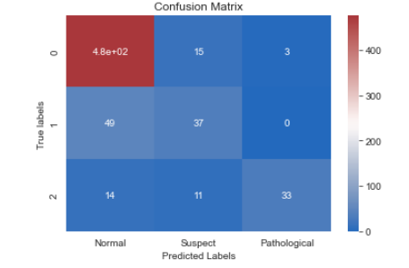
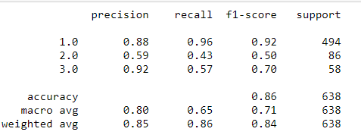
Model Creation – Logistic Regression
Classification Report

Slide 8
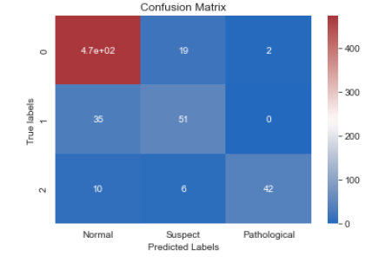
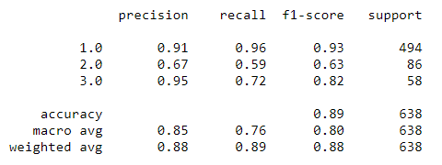
Model Creation – KNN
Classification Report

Slide 9
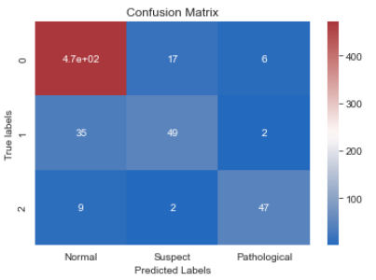
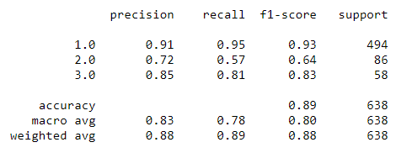
Model Creation – Random forest classifier
Classification Report
Notes:
This classification model is beneficial to physicians and because it decreases prediction errors which in turn can decrease mortality rates.

Slide 10
Resources
Kaggle: https://www.kaggle.com/andrewmvd/fetal-health-classification
Thank you!!
Any questions & feedback?

